Slide 1
Design and Analysis of Algorithms
Sid Nath (snath@scu.edu)
Lecture 15
Nov 14, 2022

Slide 2
Agenda
Administrative
Intractability

Slide 3
Administrative
No algo design questions on global opto, approx. and randomized algo topics. At most, short-answer qs.
Finals details announced
Part 1 (take-home, 6hrs, 4-5 algo design questions)
Sat Dec 3, 2022 2p-8p (finalized)
Part 2 (in-class)

Slide 4

Algo Design Patterns So far
Divide and Conquer
Greedy
Dynamic programming
Duality
Polynomial algorithms $O\left(n^{k}\right)$ can scale to huge problems

Slide 5
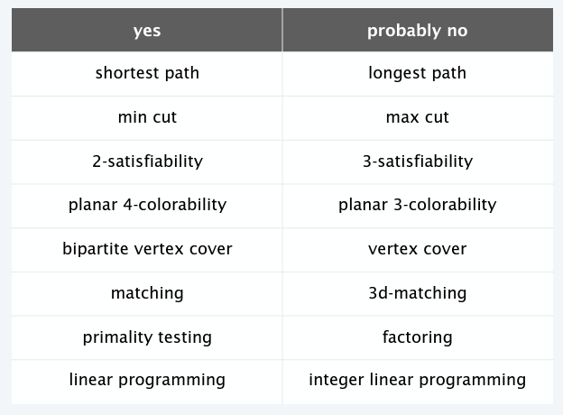
Solvable in practice

Slide 6
Classify problems
Solvable in poly-time or not
Given a constant-size program, does it halt in at most k steps?
Given a board position in an n x n generalization of checkers, can black guarantee a win?
Suppose we solve problem Y in poly-time, what else can we solve in poly-time?
Problem X reduces to Y if arbitrary instances of problem X can be solved using
Poly #standard computations steps, and
Poly #calls to oracle that solves Y
Reductions classify problems according to relative difficulty

Slide 7
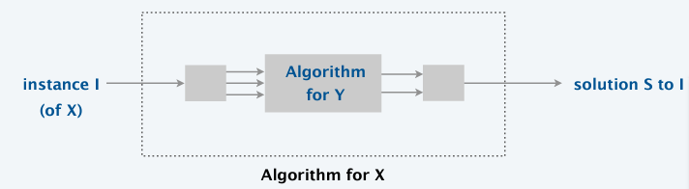
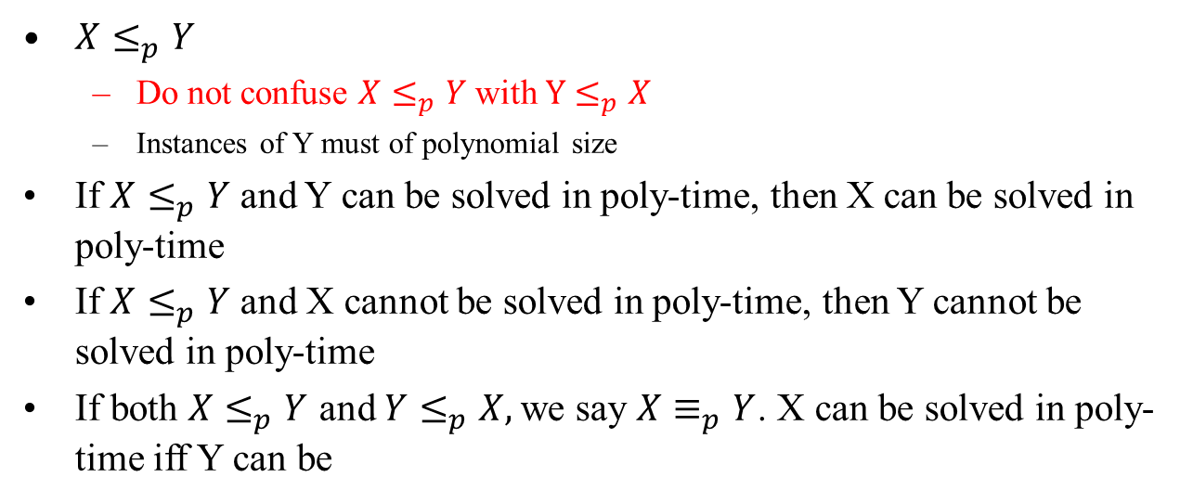
Polynomial time reductions
$X≤_{p}Y$
Do not confuse $X≤_{p}Y$ with $Y≤_{p}X$
Instances of Y must of polynomial size
If $X≤_{p}Y$ and Y can be solved in poly-time, then X can be solved in poly-time
If $X≤_{p}Y$ and X cannot be solved in poly-time, then Y cannot be solved in poly-time
If both $X≤_{p}Y$ and $Y≤_{p}X,$we say $X≡_{p}Y$. X can be solved in poly-time iff Y can be

Slide 8
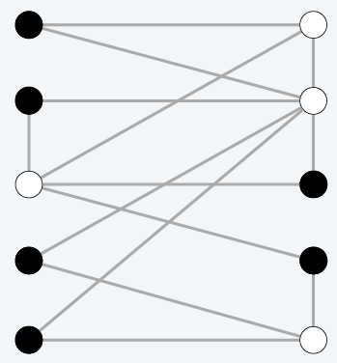

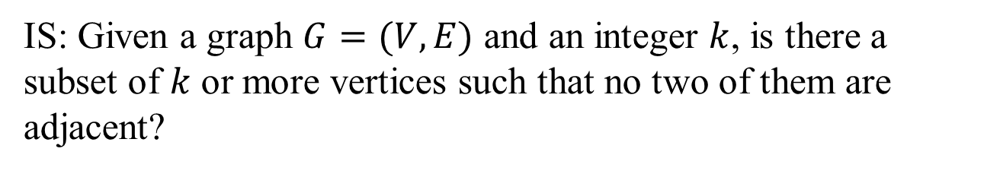
Independent Set (IS)
IS: Given a graph $G=(V,E)$ and an integer $k$, is there a subset of $k$ or more vertices such that no two of them are adjacent?

Slide 9
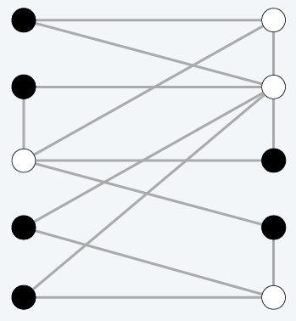

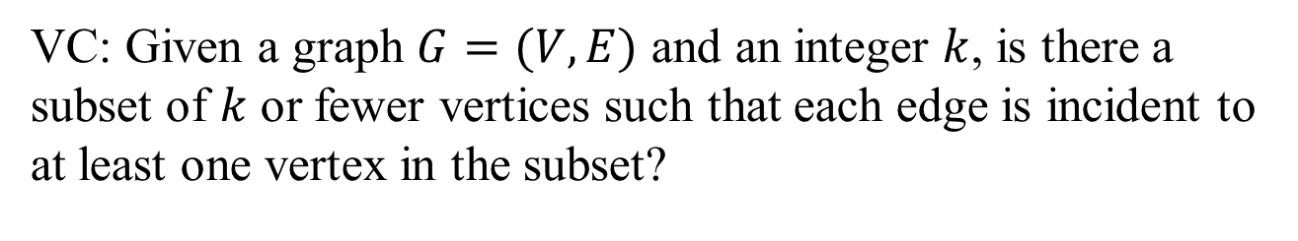
Vertex Cover (VC)
VC: Given a graph $G=(V,E)$ and an integer $k$, is there a subset of $k$ or fewer vertices such that each edge is incident to at least one vertex in the subset?

Slide 10
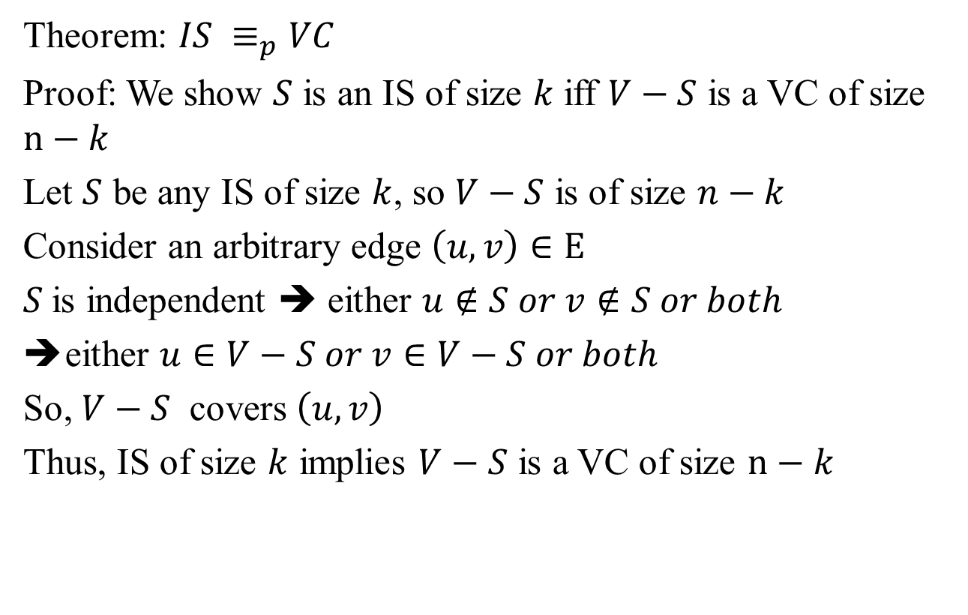
VC and IS reduce to one another
Theorem: $IS ≡_{p}VC$
Proof: We show $S$ is an IS of size $k$ iff $V−S$ is a VC of size $n−k$
Let $S$ be any IS of size $k$, so $V−S$ is of size $n−k$
Consider an arbitrary edge $\left(u,v\right)∈E$
$S$is independent ➔ either $u∉S or v∉S or both$
either $u∈V−S or v∈V−S or both$
So, $V−S$ covers $\left(u,v\right)$
Thus, IS of size $k$ implies $V−S$ is a VC of size $n−k$

Slide 11
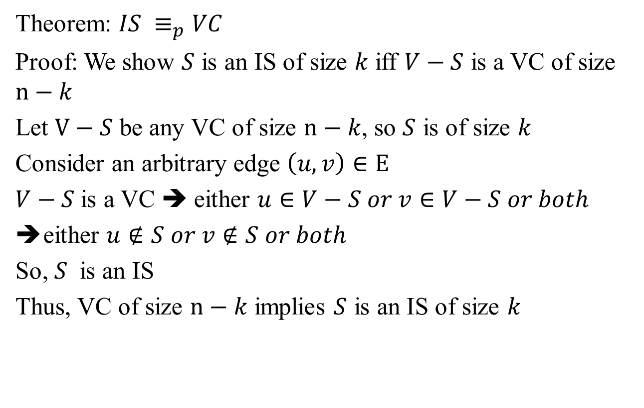
VC and IS reduce to one another
Theorem: $IS ≡_{p}VC$
Proof: We show $S$ is an IS of size $k$ iff $V−S$ is a VC of size $n−k$
Let $V−S$ be any VC of size $n−k$, so $S$ is of size $k$
Consider an arbitrary edge $\left(u,v\right)∈E$
$V−S$is a VC ➔ either $u∈V−S or v∈V−S or both$
either $u∉S or v∉S or both$
So, $S$ is an IS
Thus, VC of size $n−k$ implies $S$ is an IS of size $k$

Slide 12
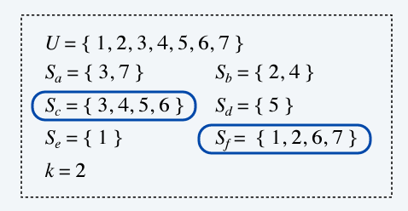
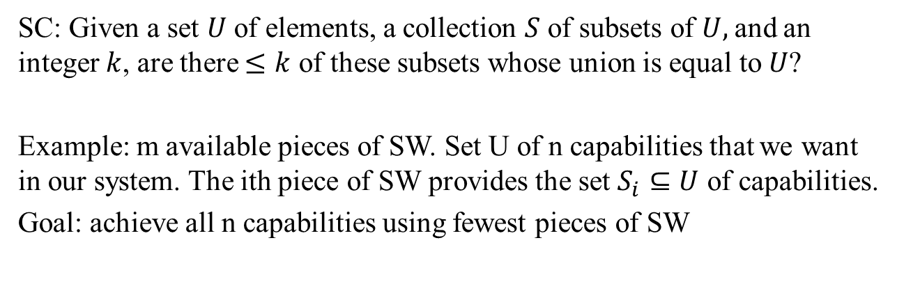
Set Cover (SC)
SC: Given a set $U$ of elements, a collection $S$ of subsets of $U,$and an integer $k$, are there $≤k$ of these subsets whose union is equal to $U$?
Example: m available pieces of SW. Set U of n capabilities that we want in our system. The ith piece of SW provides the set $S_{i}⊆U$ of capabilities.
Goal: achieve all n capabilities using fewest pieces of SW

Slide 13
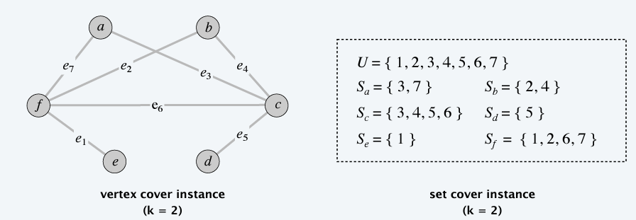
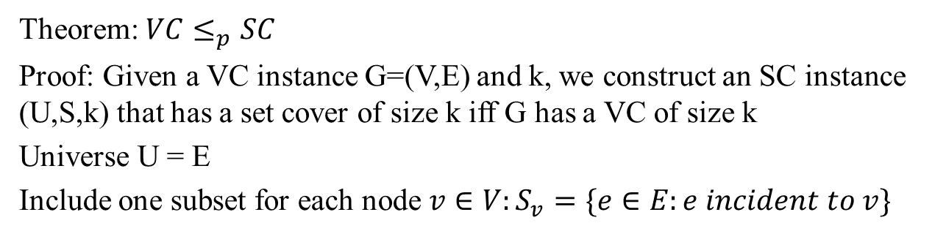
VC reduces to SC
Theorem: $VC≤_{p}SC$
Proof: Given a VC instance G=(V,E) and k, we construct an SC instance (U,S,k) that has a set cover of size k iff G has a VC of size k
Universe U = E
Include one subset for each node $v∈V:S_{v}=\{e∈E:e incident to v\}$

Slide 14
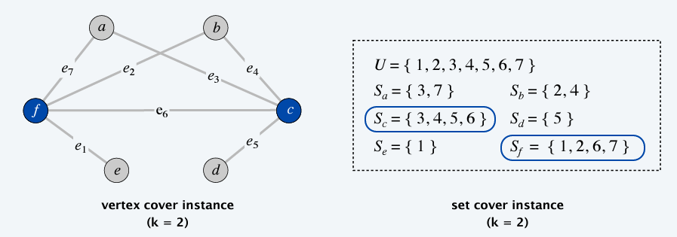
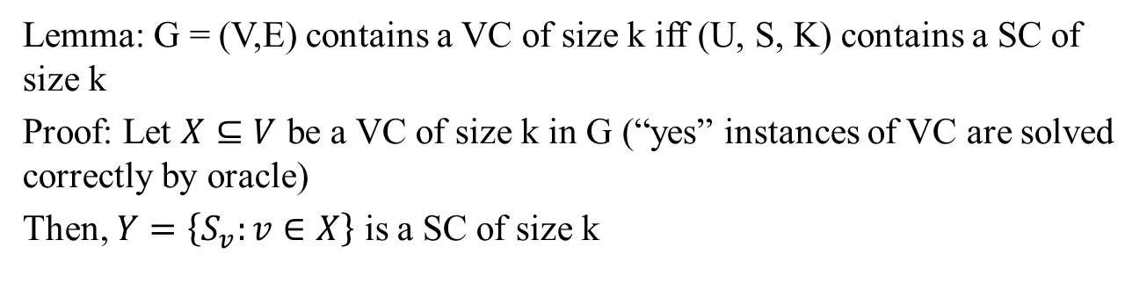
VC reduces to SC
Lemma: G = (V,E) contains a VC of size k iff (U, S, K) contains a SC of size k
Proof: Let $X⊆V$ be a VC of size k in G (“yes” instances of VC are solved correctly by oracle)
Then, $Y=\left\{S_{v}:v∈X\right\}$ is a SC of size k

Slide 15
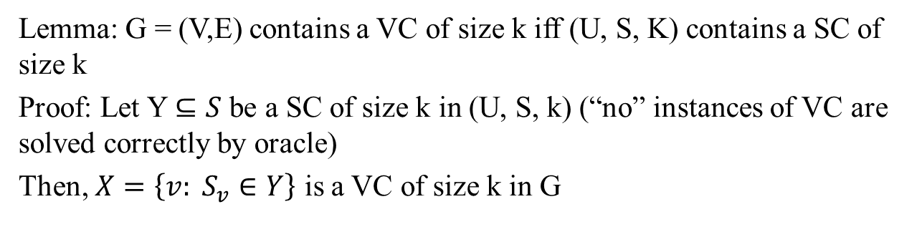
VC reduces to SC
Lemma: G = (V,E) contains a VC of size k iff (U, S, K) contains a SC of size k
Proof: Let Y $⊆S$ be a SC of size k in (U, S, k) (“no” instances of VC are solved correctly by oracle)
Then, $X=\left\{v: S_{v}∈Y\right\}$ is a VC of size k in G

Slide 16
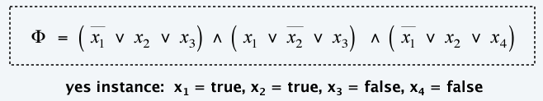
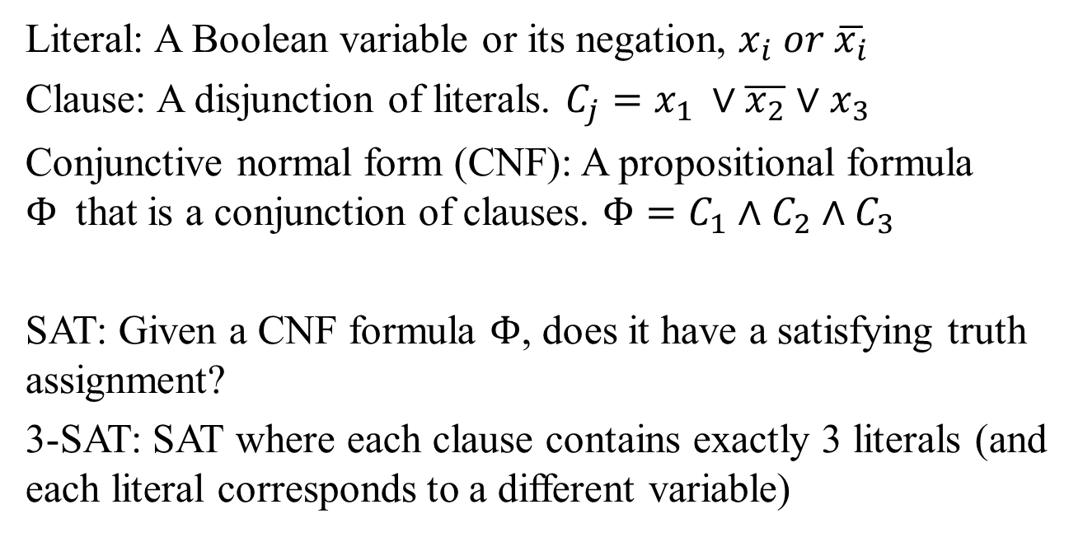
Satisfiability
Literal: A Boolean variable or its negation, $x_{i} or \overline{x_{i}}$
Clause: A disjunction of literals. $C_{j}=x_{1} ∨\overline{x_{2}}$ $∨x_{3}$
Conjunctive normal form (CNF): A propositional formula $Φ$that is a conjunction of clauses. $Φ=C_{1}∧C_{2}∧C_{3}$
SAT: Given a CNF formula $Φ$, does it have a satisfying truth assignment?
3-SAT: SAT where each clause contains exactly 3 literals (and each literal corresponds to a different variable)

Slide 17

Satisfiability is hard
There does not exist a poly-time algorithm for 3-SAT
P vs. NP: This hypothesis is equivalent to $P≠NP$conjecture

Slide 18
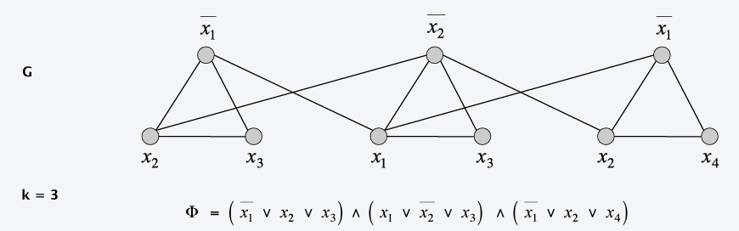
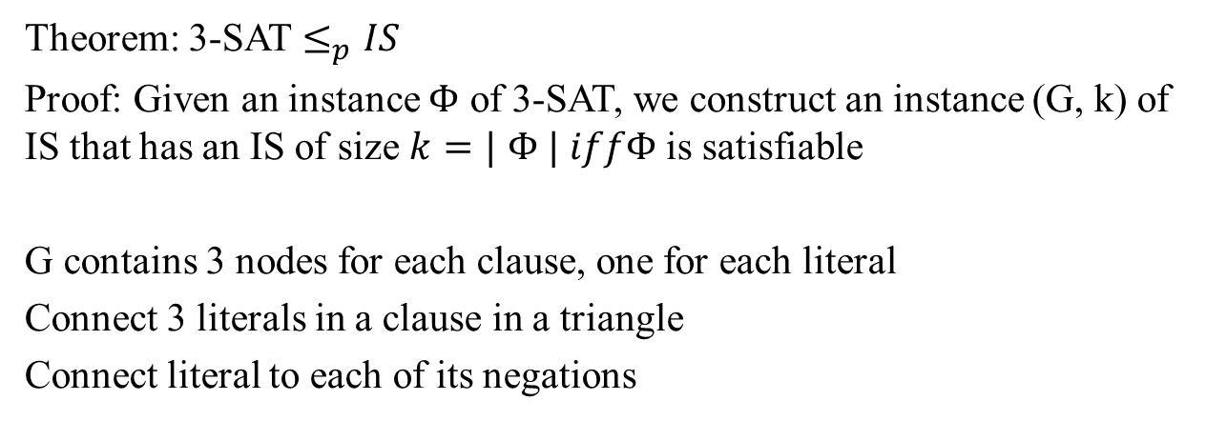
3-SAT reduces to IS
Theorem: 3-SAT $≤_{p}IS$
Proof: Given an instance $Φ$ of 3-SAT, we construct an instance (G, k) of IS that has an IS of size $k=|$ $Φ | iffΦ$ is satisfiable
G contains 3 nodes for each clause, one for each literal
Connect 3 literals in a clause in a triangle
Connect literal to each of its negations

Slide 19
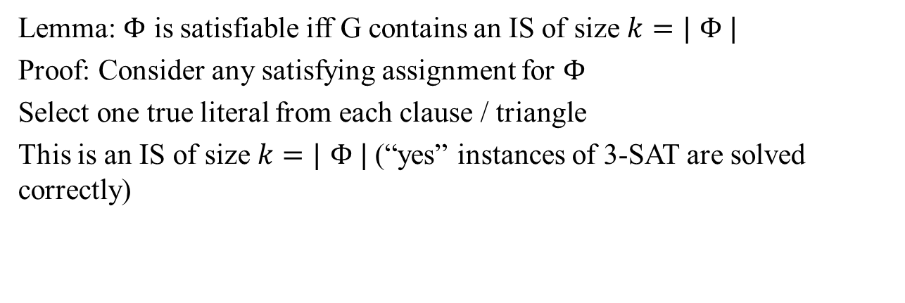
3-SAT reduces to IS
Lemma: $Φ$ is satisfiable iff G contains an IS of size $k=|$ $Φ |$
Proof: Consider any satisfying assignment for $Φ$
Select one true literal from each clause / triangle
This is an IS of size $k=|$ $Φ |$ (“yes” instances of 3-SAT are solved correctly)

Slide 20
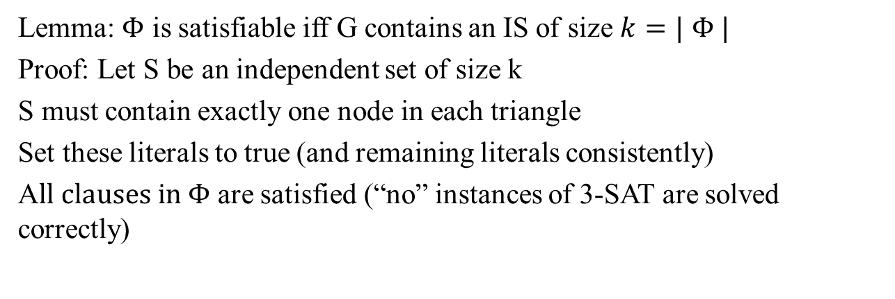
3-SAT reduces to IS
Lemma: $Φ$ is satisfiable iff G contains an IS of size $k=|$ $Φ |$
Proof: Let S be an independent set of size k
S must contain exactly one node in each triangle
Set these literals to true (and remaining literals consistently)
A$ll clauses in Φ$ are satisfied (“no” instances of 3-SAT are solved correctly)

Slide 21
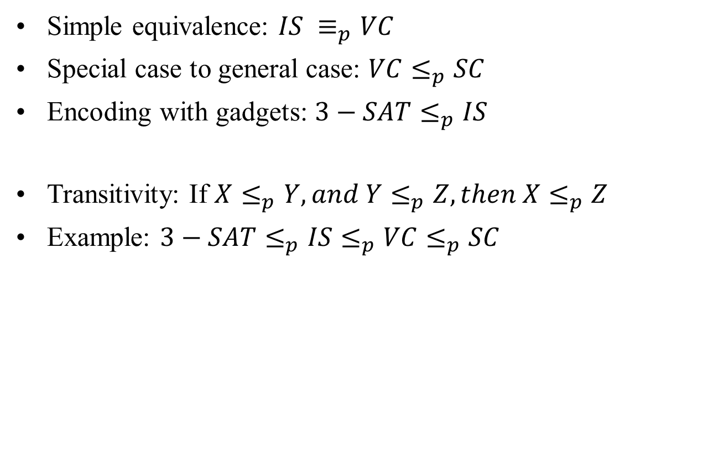
Basic Reduction Strategies
Simple equivalence: $IS ≡_{p}VC$
Special case to general case: $VC≤_{p}SC$
Encoding with gadgets: $3−SAT≤_{p}IS$
Transitivity: If $X≤_{p}Y, and Y≤_{p}Z, then X≤_{p}Z$
Example: $3−SAT≤_{p}IS≤_{p}VC≤_{p}SC$

Slide 22
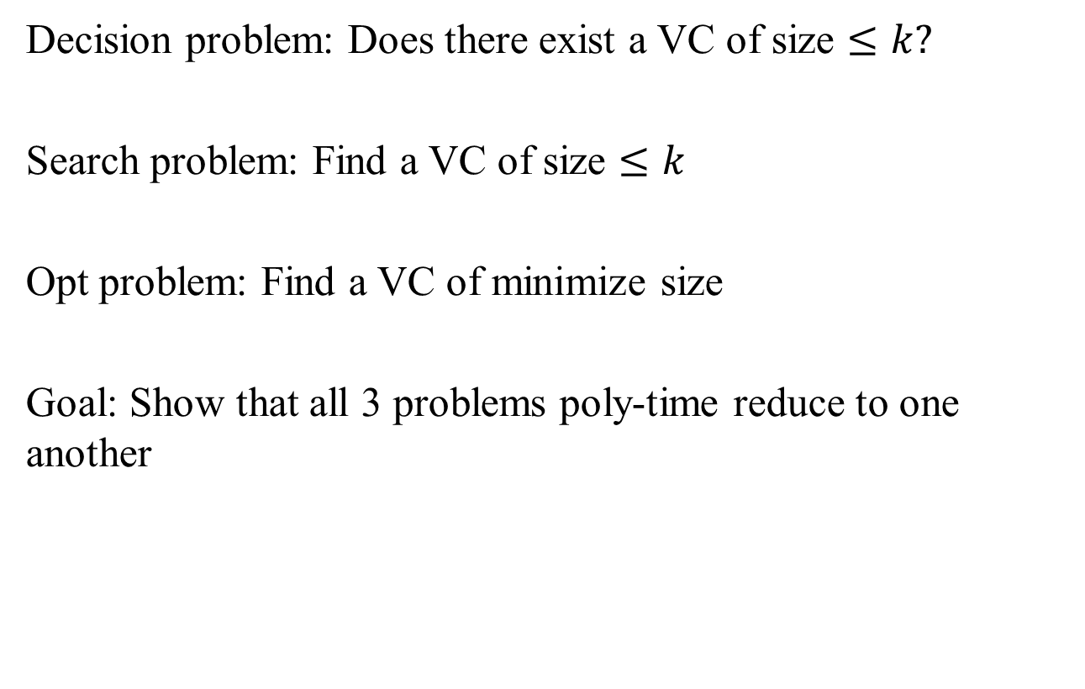
Decision, Search and Opt problems
Decision problem: Does there exist a VC of size $≤k?$
Search problem: Find a VC of size $≤k$
Opt problem: Find a VC of minimize size
Goal: Show that all 3 problems poly-time reduce to one another

Slide 23
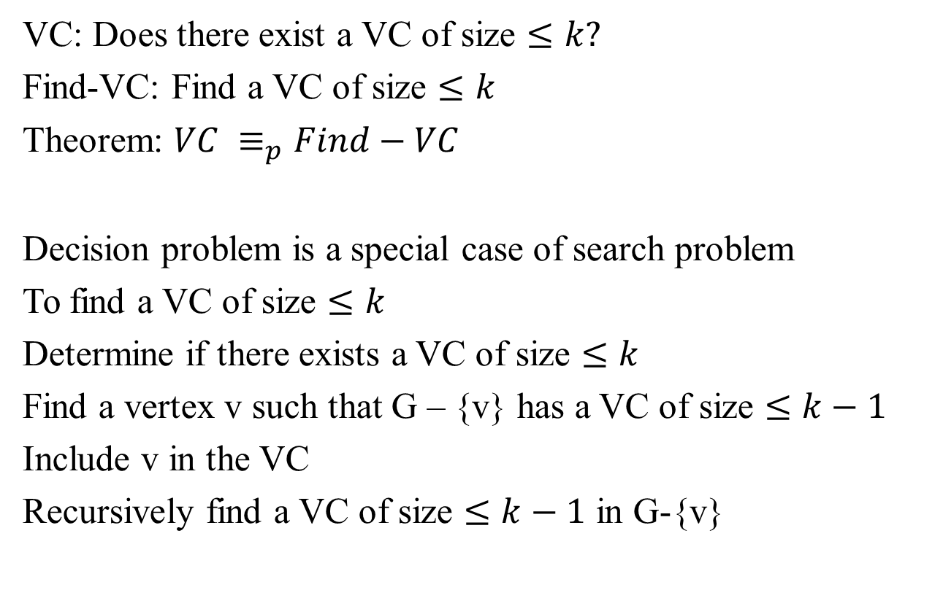
Search vs. Decision problems
VC: Does there exist a VC of size $≤k?$
Find-VC: Find a VC of size $≤k$
Theorem: $VC ≡_{p}Find−VC$
Decision problem is a special case of search problem
To find a VC of size $≤k$
Determine if there exists a VC of size $≤k$
Find a vertex v such that G – {v} has a VC of size $≤k−1$
Include v in the VC
Recursively find a VC of size $≤k−1$ in G-{v}

Slide 24
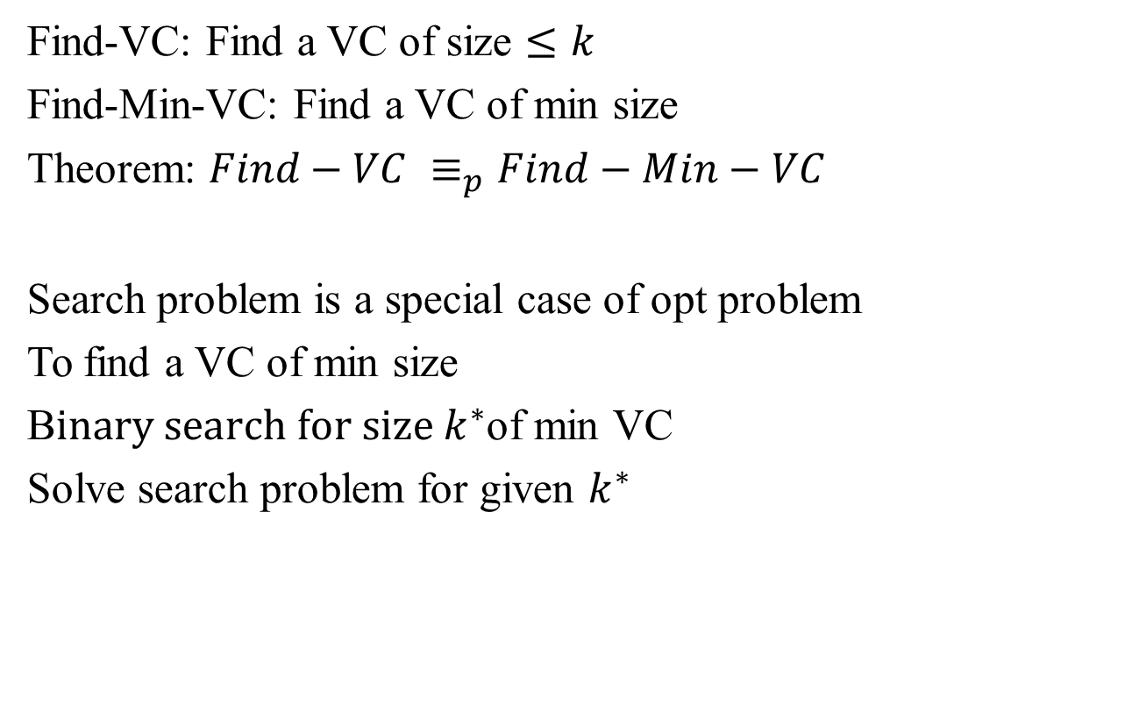
Search vs. Opt problems
Find-VC: Find a VC of size $≤k$
Find-Min-VC: Find a VC of min size
Theorem: $Find−VC ≡_{p}Find−Min−VC$
Search problem is a special case of opt problem
To find a VC of min size
B$inary search for size k^{∗}$of min VC
Solve search problem for given $k^{∗}$

Slide 25
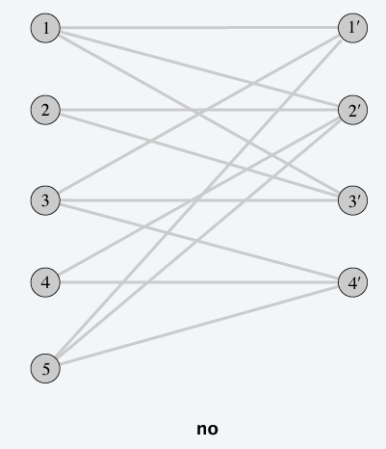
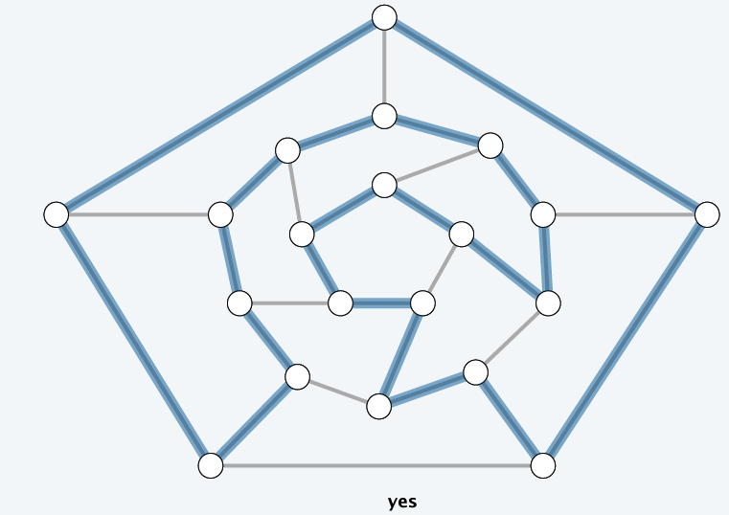
Hamiltonian / Rudrata Cycle
Given an undirected graph G = (V, E), does there exist a cycle that visits every node exactly once?

Slide 26
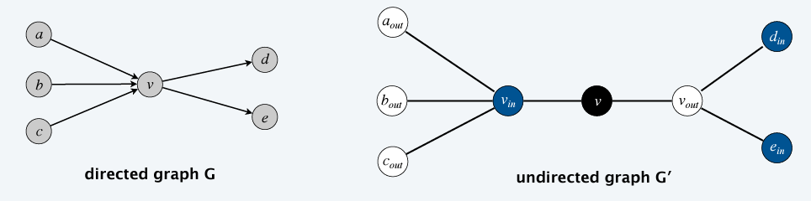
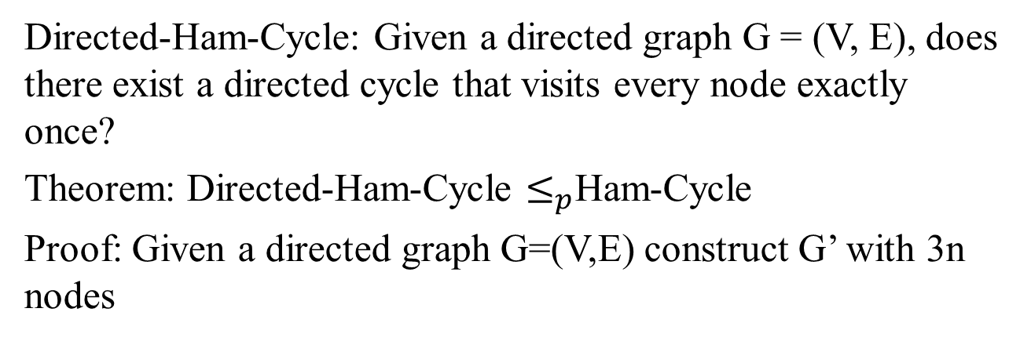
Directed Ham-Cycle reduces to Ham-Cycle
Directed-Ham-Cycle: Given a directed graph G = (V, E), does there exist a directed cycle that visits every node exactly once?
Theorem: Directed-Ham-Cycle $≤_{p}$Ham-Cycle
Proof: Given a directed graph G=(V,E) construct G’ with 3n nodes

Slide 27
Directed Ham-Cycle reduces to Ham-Cycle
Lemma: G has a directed Ham-Cycle iff G’ has a Ham-Cycle
Proof:
Suppose G has a directed Ham-Cycle, then G’ has an undirected Ham-Cycle (same order)
Suppose G’ has an undirected Ham-Cycle
The cycle must visit nodes in G’ using one of following 2 orders: {b, w, bl, b, w, bl, b, w, bl, …. } or {b, bl, w, b, bl, w, …}
Black nodes in cycle comprise either a directed Ham-Cycle in G or a reverse of one

Slide 28
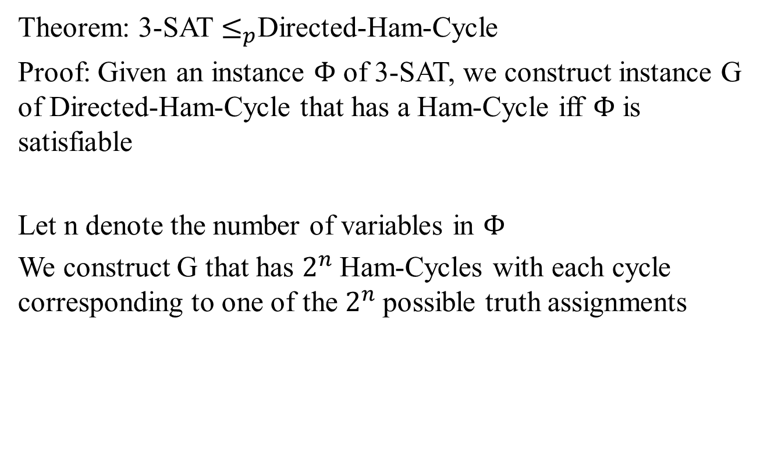
3-SAT reduces to directed Ham-Cycle
Theorem: 3-SAT $≤_{p}$Directed-Ham-Cycle
Proof: Given an instance $Φ$ of 3-SAT, we construct instance G of Directed-Ham-Cycle that has a Ham-Cycle iff $Φ$ is satisfiable
Let n denote the number of variables in $Φ$
We construct G that has $2^{n}$Ham-Cycles with each cycle corresponding to one of the $2^{n}$possible truth assignments

Slide 29
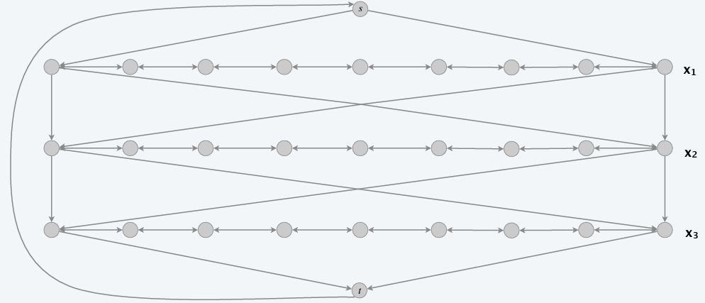
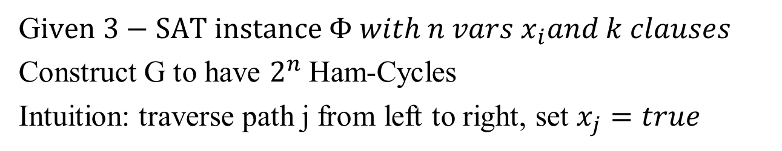
3-SAT reduces to directed Ham-Cycle
G$iven 3−SAT instance Φ with n vars x_{i}and k clauses$
Construct G to have $2^{n}$Ham-Cycles
Intuition: traverse path j from left to right, set $x_{j}=true$

Slide 30
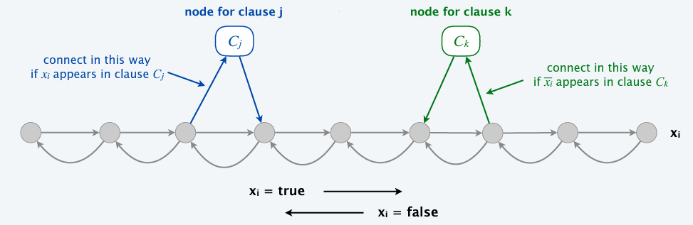
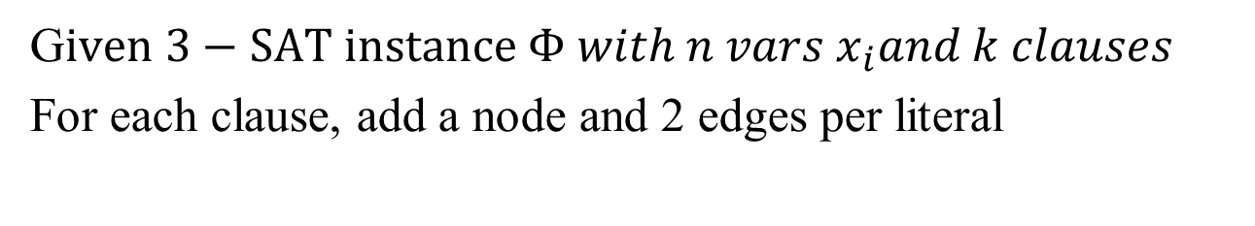
3-SAT reduces to directed Ham-Cycle
G$iven 3−SAT instance Φ with n vars x_{i}and k clauses$
For each clause, add a node and 2 edges per literal

Slide 31
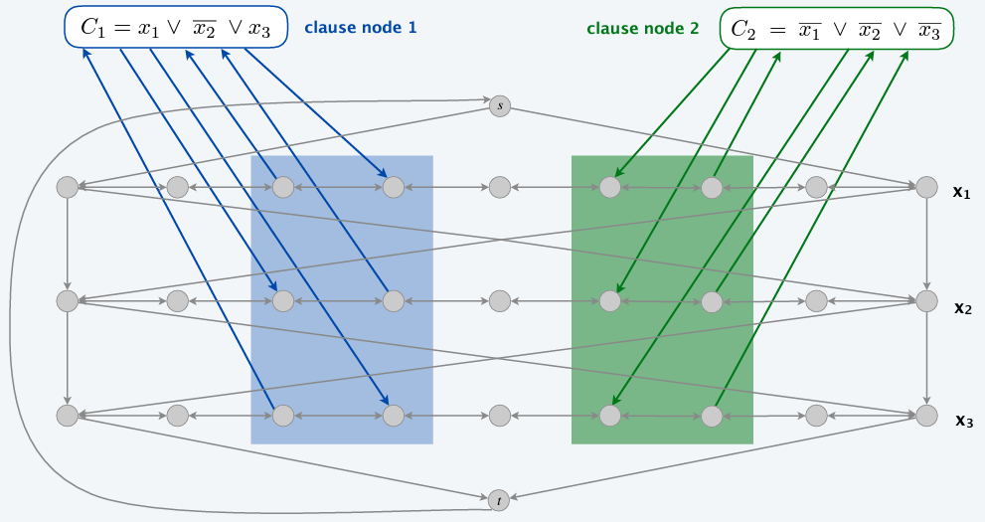
3-SAT reduces to directed Ham-Cycle
G$iven 3−SAT instance Φ with n vars x_{i}and k clauses$
For each clause, add a node and 2 edges per literal

Slide 32
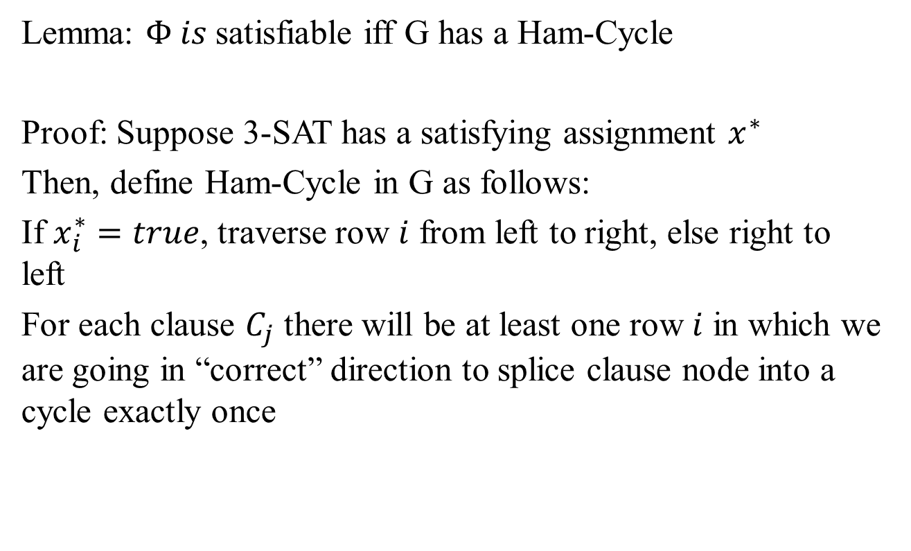
3-SAT reduces to directed Ham-Cycle
Lemma: $Φ is$satisfiable iff G has a Ham-Cycle
Proof: Suppose 3-SAT has a satisfying assignment $x^{∗}$
Then, define Ham-Cycle in G as follows:
If $x_{i}^{∗}=true$, traverse row $i$ from left to right, else right to left
For each clause $C_{j}$ there will be at least one row $i$ in which we are going in “correct” direction to splice clause node into a cycle exactly once

Slide 33
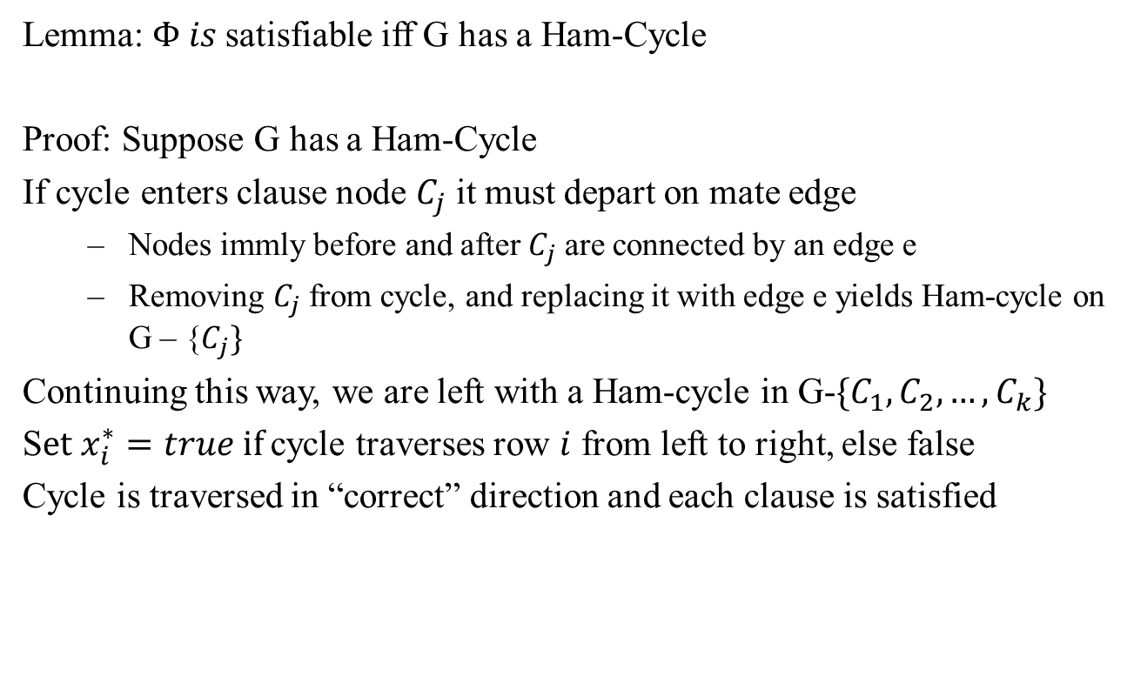
3-SAT reduces to directed Ham-Cycle
Lemma: $Φ is$satisfiable iff G has a Ham-Cycle
Proof: Suppose G has a Ham-Cycle
If cycle enters clause node $C_{j}$ it must depart on mate edge
Nodes immly before and after $C_{j}$ are connected by an edge e
Removing $C_{j}$ from cycle, and replacing it with edge e yields Ham-cycle on G – {$C_{j}\}$
Continuing this way, we are left with a Ham-cycle in G-$\{C_{1},C_{2},…, C_{k}\}$
S$et x_{i}^{∗}=true if$cycle traverses row $i$ from left to right, else false
Cycle is traversed in “correct” direction and each clause is satisfied

Slide 34
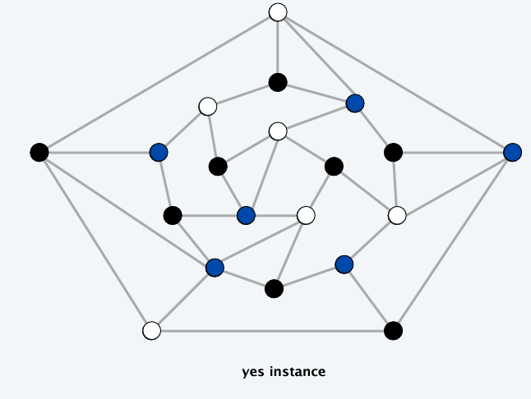
3-Colorability
3-Color: Given an undirected graph G, can the nodes be colored black, white and blue so that no adjacent nodes have the same color?

Slide 35
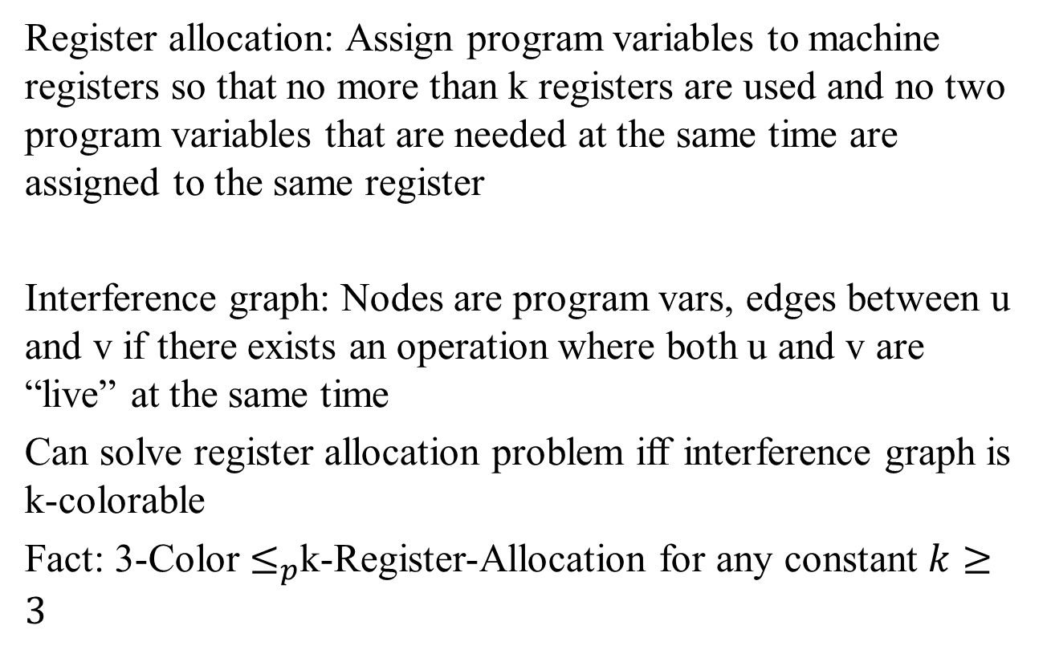
Applications
Register allocation: Assign program variables to machine registers so that no more than k registers are used and no two program variables that are needed at the same time are assigned to the same register
Interference graph: Nodes are program vars, edges between u and v if there exists an operation where both u and v are “live” at the same time
Can solve register allocation problem iff interference graph is k-colorable
Fact: 3-Color $≤_{p}$k-Register-Allocation for any constant $k≥3$

Slide 36

3-SAT reduces to 3-Color
Theorem: 3-SAT $≤_{p}$ 3-Color
Proof: Given a 3-SAT instance $Φ$, we construct an instance of 3-Color that is 3-Colorable iff $Φ$ is satisfiable

Slide 37
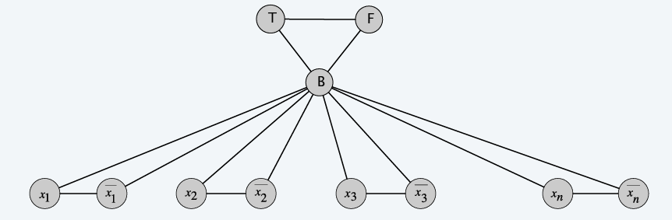
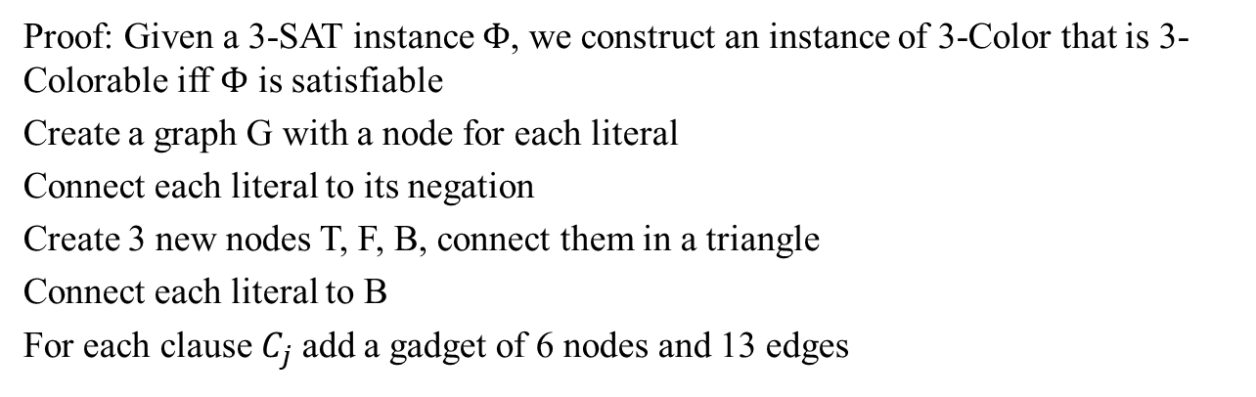
3-SAT reduces to 3-Color
Proof: Given a 3-SAT instance $Φ$, we construct an instance of 3-Color that is 3-Colorable iff $Φ$ is satisfiable
Create a graph G with a node for each literal
Connect each literal to its negation
Create 3 new nodes T, F, B, connect them in a triangle
Connect each literal to B
For each clause $C_{j}$ add a gadget of 6 nodes and 13 edges

Slide 38
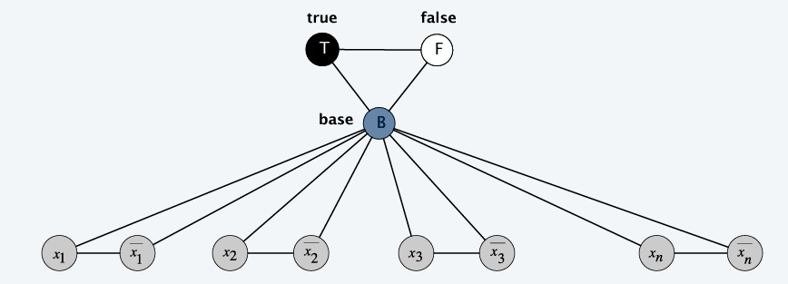
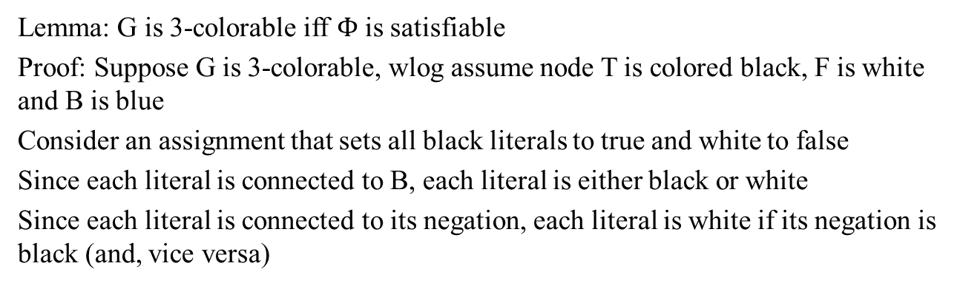
3-SAT reduces to 3-Color
Lemma: G is 3-colorable iff $Φ$ is satisfiable
Proof: Suppose G is 3-colorable, wlog assume node T is colored black, F is white and B is blue
Consider an assignment that sets all black literals to true and white to false
Since each literal is connected to B, each literal is either black or white
Since each literal is connected to its negation, each literal is white if its negation is black (and, vice versa)

Slide 39
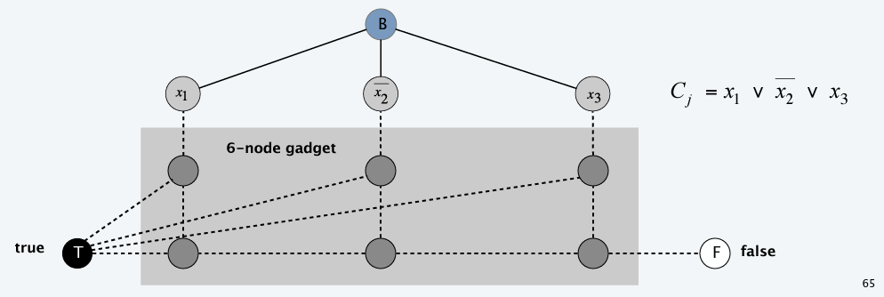
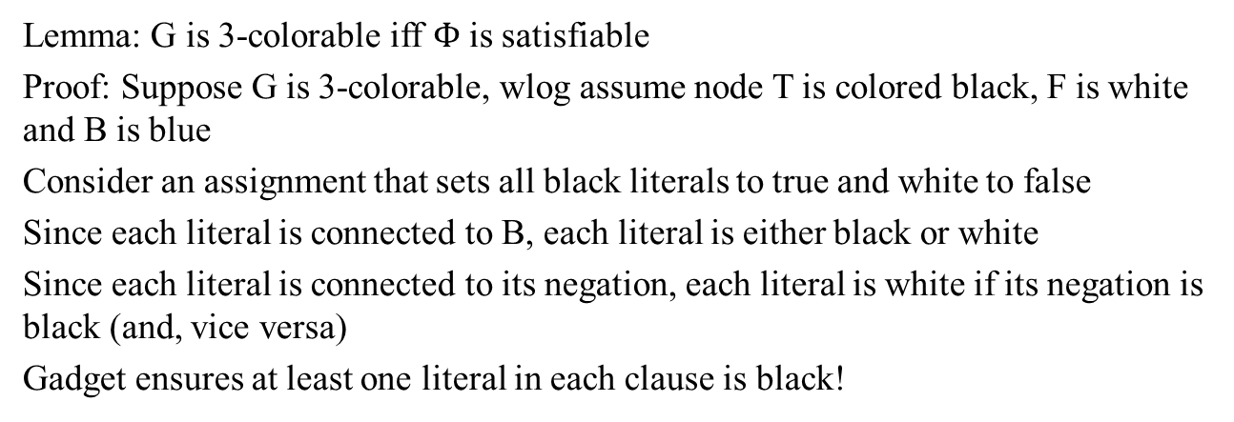
3-SAT reduces to 3-Color
Lemma: G is 3-colorable iff $Φ$ is satisfiable
Proof: Suppose G is 3-colorable, wlog assume node T is colored black, F is white and B is blue
Consider an assignment that sets all black literals to true and white to false
Since each literal is connected to B, each literal is either black or white
Since each literal is connected to its negation, each literal is white if its negation is black (and, vice versa)
Gadget ensures at least one literal in each clause is black!

Slide 40
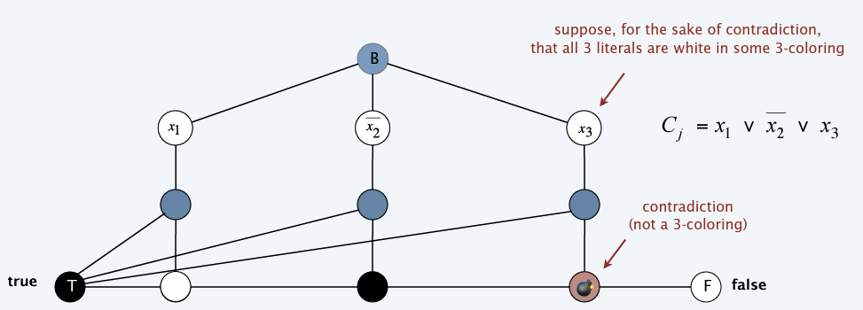

3-SAT reduces to 3-Color
Lemma: G is 3-colorable iff $Φ$ is satisfiable
Proof: Suppose G is 3-colorable, wlog assume node T is colored black, F is white and B is blue
Consider an assignment that sets all black literals to true and white to false
Since each literal is connected to B, each literal is either black or white
Since each literal is connected to its negation, each literal is white if its negation is black (and, vice versa)
Gadget ensures at least one literal in each clause is black!

Slide 41


3-SAT reduces to 3-Color
Lemma: G is 3-colorable iff $Φ$ is satisfiable
Proof: Suppose 3-SAT instance $Φ$ is satisfiable
Color all true literals black and all false literals white
Pick one true literal, color node below that node as white and node below that as blue
Color remaining middle row nodes as blue
Color remaining bottom nodes as black or white, as forced.

Slide 42
Subset Sum
Given n natural numbers and an integer W, is there a subset that adds up to exactly W?
Ex. { 215, 215, 275, 275, 355, 355, 420, 420, 580, 580, 655, 655 }, W = 1505.
Yes. 215 + 355 + 355 + 580 = 1505.
With arithmetic problems, input integers are encoded in binary. Poly-time reduction must be polynomial in binary encoding.

Slide 43

Subset Sum reduces to Knapsack
Knapsack: Given a set of X items, weights $u_{i}≥0, values v_{i}≥0$, a weight limit U and a target value V, is there a subset $S⊆X$such that
$$\sum_{i∈S}{u_{i}≤U, \sum_{i∈S}{v_{i}≥V}}$$
We used DP to solve in O(nU)
Subset-Sum $≤_{p}$Knapsack

Slide 44

Poly-time reductions

Slide 45

Karp’s 20 poly-time reductions from Satisfiability

Slide 46
Lecture 15 Summary
Intractability

Slide 47

Extra Credit Qs #10 [9 points]
Please email your responses to snath@scu.edu by 7:09pm of Nov 16, 2022
We stated the Subset-Sum problem as: Given n natural numbers and an integer W, is there a subset that adds up to exactly W?
We stated the Knapsack problem as: Given a set of X items, weights $u_{i}≥0, values v_{i}≥0$, a weight limit U and a target value V, is there a subset $S⊆X$such that
$$\sum_{i∈S}{u_{i}≤U, \sum_{i∈S}{v_{i}≥V}}$$
Question: To prove Subset-Sum $≤_{p}$Knapsack, can you create an instance of Subset-Sum and show how to reduce it to an instance of the Knapsack problem? Please use the same notation as above to receive any credit.

